Slide 1
My summer experience with Allscripts
Aditya Paruchuri Software Engineer Intern
Team Notivation (TouchWorks EHR)
Team Stork (Prenatal)

Slide 2
What I’ll cover…
Introduction to myself
Tasks contributed to Allscripts
Summary of my work with Team Notivation
Summary of my work with Team Stork
Lessons learned, application to school coursework, wrap-up

Slide 3
About me…
Charlotte, NC
Rising sophomore at Duke
B.S. Computer Science
Minor in History
Freelance web developer
www.AdityaParuchuri.com
GitHub: @Aditya-Tech

Slide 4
What I worked on this summer…
HTML Note Output Generator
Transitioning TouchWorks’ note generation from RTF to HTML format
Tech used: JavaScript, Python, HTML, CSS, jQuery, ASP.NET MVC 5
Modernization of Silverlight Application
Converting Prenatal’s Admin App from Silverlight to a more modern UI/UX
Tech used: JavaScript, HTML, CSS, jQuery, AngularJS

Slide 5
HTML Note Output Generator
TouchWorks’ Note feature
Flow:
Inputs: Patient data and metadata in XML format
Output: Formatted and styled HTML note
Why?
Reusable “stylesheets”
More styling and formatting options
Saves space in TouchWorks’ database
Challenges
Infinite ways notes can be formatted
Sheer number of note elements that currently exist
Tech used: JavaScript, Python, HTML, CSS, jQuery, ASP.NET MVC 5

Slide 6
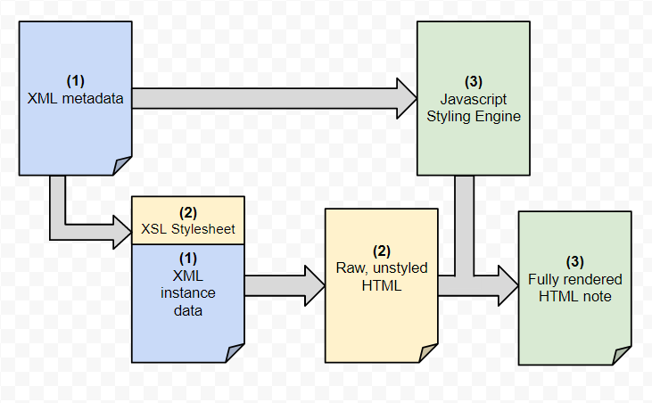
Figure 1: Process flow for HTML Note Output Generator (Diagram by Dustin Lambright)

Slide 7
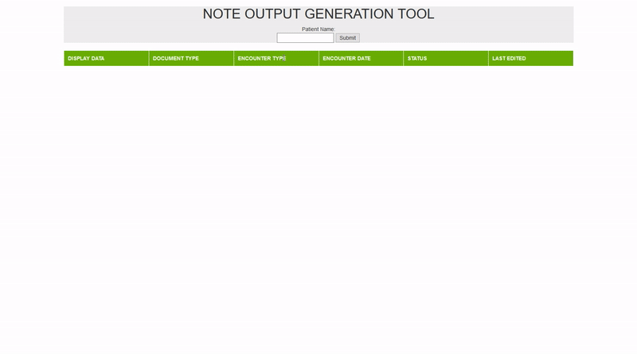
Figure 2: See the HTML Note Output Generator in action.

Slide 8
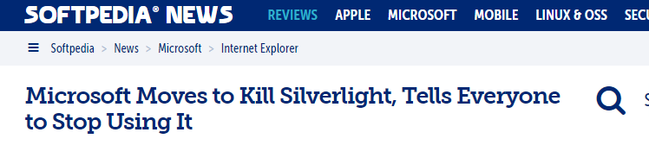
Modernization of Prenatal’s Silverlight Admin Application
Silverlight -> Latest HTML/CSS/JS
Why?
Security vulnerabilities in Silverlight
Single-page applications trend
HTML looks better
Challenges
Configuring server requests
Testing
Tech used: JavaScript, HTML, CSS, jQuery, AngularJS

Slide 9
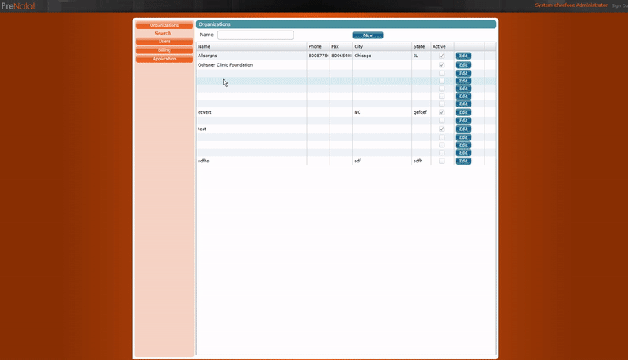
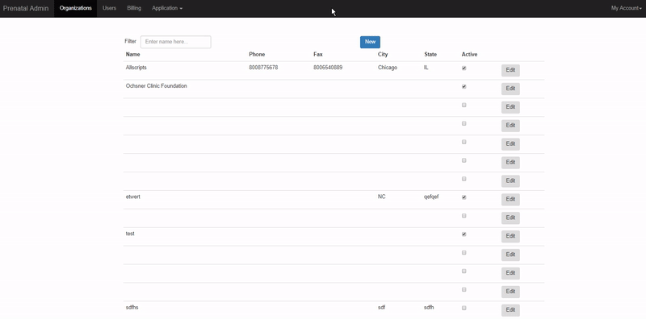
Figure 4: Admin App (Modern Version)
Figure 3: Admin App (Silverlight Version)

Slide 10


Wrap up
Advice to future interns:
Master your version control software ASAP
Invest time into examining your team’s codebase
Use the technologies that you are most comfortable with, if applicable
Application to school work:
Knowledge of data structures and algorithms
Principles of constructing unit tests
Favorite aspects of the internship:
Giving bi-weekly demos
Volunteering at a cat shelter

Slide 11
Questions?

